Slide 1
Probability Review and
Intro to Bayes Nets

Slide 2
Probability
The world is a very uncertain place.
As of this point, we’ve basically danced around that fact. We’ve assumed that what we see in the world is really there, what we do in the world has predictable outcomes, etc.

Slide 3
Some limitations we’ve encountered so far ...
B
A
move(A,up) = B
move(A,down) = C
C
In the search algorithms we’ve explored so far, we’ve assumed a deterministic relationship between moves and successors

Slide 4
Some limitations we’ve encountered so far ...
0.5
B
move(A,up) = B 50% of the time
move(A,up) = C 50% of the time
A
0.5
C
Lots of problems aren’t this way!

Slide 5
Some limitations we’ve encountered so far ...
B
Based on what we see, there’s a 30% chance we’re in A, 30% in B and 40% in C ....
A
C
Moreover, lots of times we don’t know exactly where we are in our search ...

Slide 6
How to cope?
We have to incorporate probability into our graphs, to help us reason and make good decisions.
This requires a review of probability basics.

Slide 7
Boolean Random Variable
A boolean random variable is a variable that can be true or false with some probability.
A = The next president is a liberal.
A = You wake up tomorrow with a headache.
A = You have the flu.

Slide 8
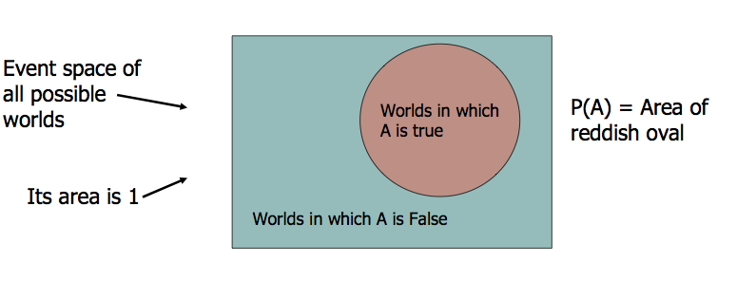
Visualizing P(A)
Call P(A) as “the fraction of possible worlds in which A is true”. Let’s visualize this:

Slide 9
The axioms of probability
0 <= P(A) <= 1
P(True) = 1
P(False) = 0
P(A or B) = P(A) + P(B) - P(A and B)
We will visualize each of these axioms in turn.

Slide 10
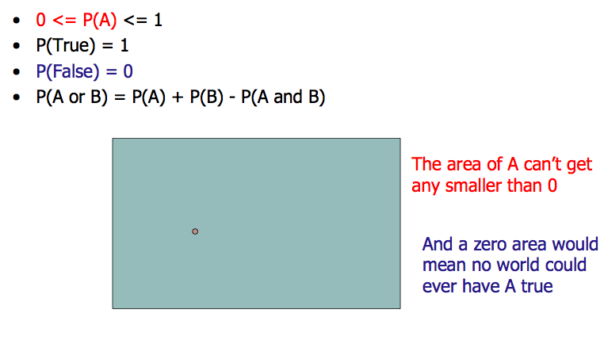
Visualizing the axioms

Slide 11
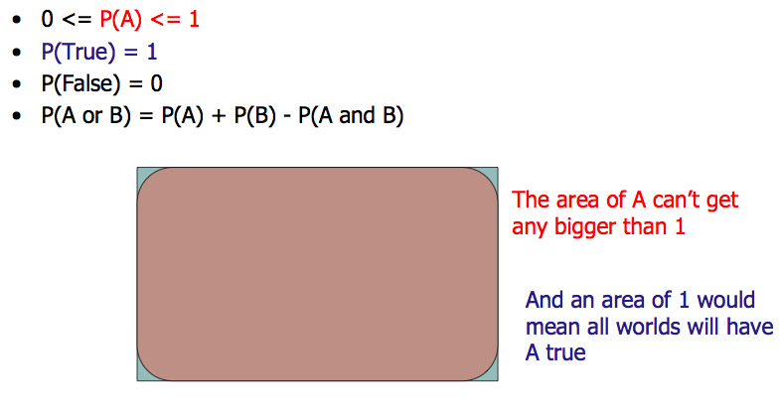
Visualizing the axioms

Slide 12
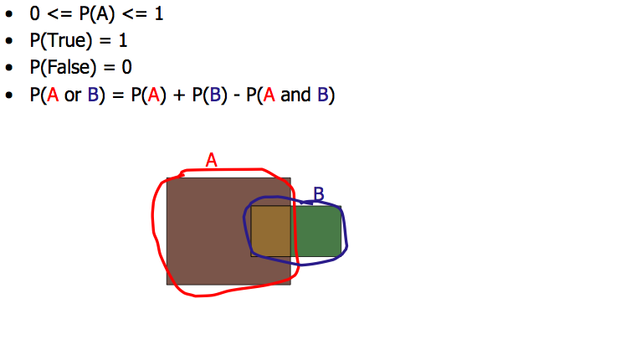
Visualizing the axioms

Slide 13
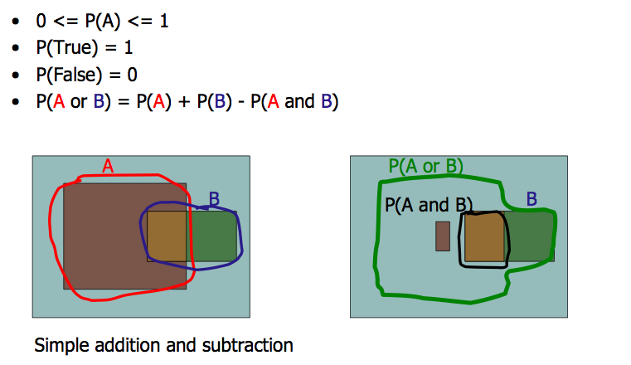
Visualizing the axioms

Slide 14
Theorems from the axioms
0 <= P(A) <= 1
P(True) = 1
P(False) = 0
P(A or B) = P(A) + P(B) - P(A and B)
From these we can prove: P(not A) = P(~A) = 1-P(A).

Slide 15
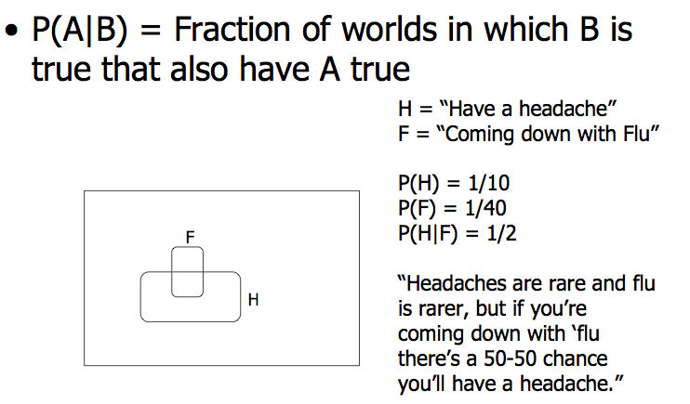
Conditional Probability

Slide 16
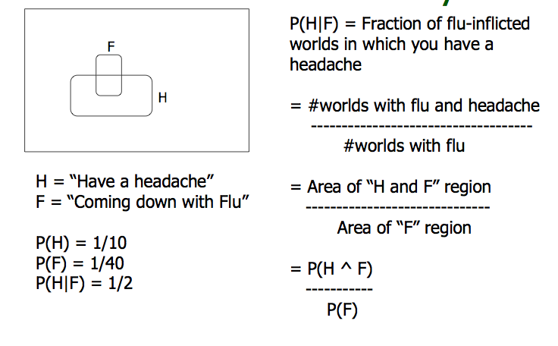
Conditional Probability

Slide 17
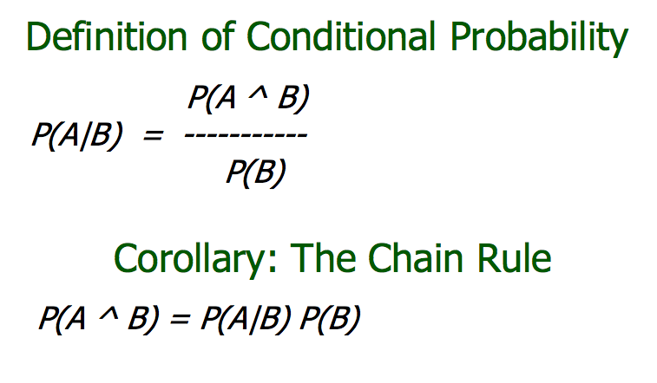

Slide 18
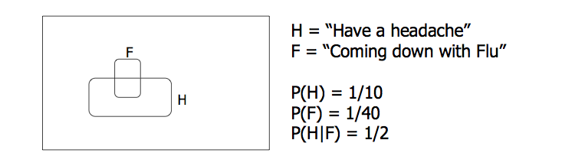
Reasoning with Conditional Probability
One day you wake up with a headache. You think: “Drat!
50% of flu cases are associated with headaches so I must have a
50-50 chance of coming down with flu”.
Is that good reasoning?

Slide 19
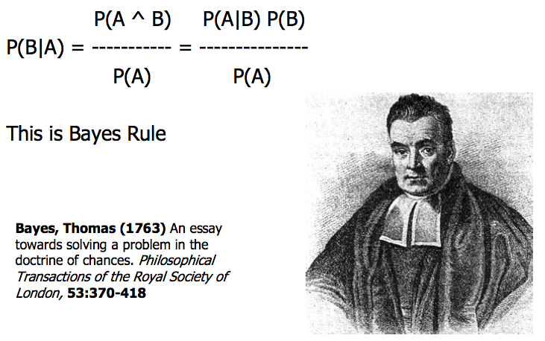
What we just did, more formally.

Slide 20
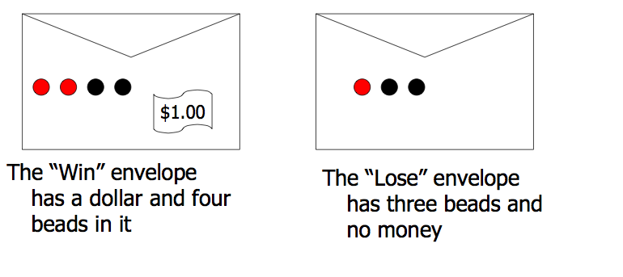
Using Bayes Rule to gamble
Trivial question: Someone picks an envelope and random and asks you to bet as to whether or not it holds a dollar. What are your odds?

Slide 21
Using Bayes Rule to gamble
Not trivial question: Someone lets you take a bead out of the envelope before you bet. If it is black, what are your odds? If it is red, what are your odds?

Slide 22
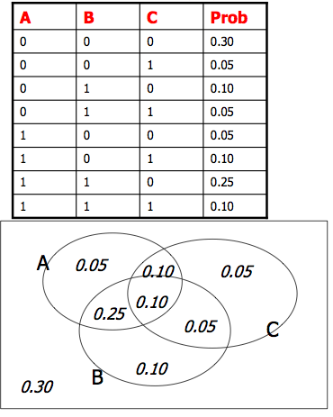
Joint Distributions
Boolean variables A, B and C
A joint distribution records the probabilities that multiple variables will hold particular values. They can be represented much like truth tables.
They can be populated using expert knowledge, by using the axioms of probability, or by actual data.
Note that the sum of all the probabilities MUST be 1, in order to satisfy the axioms of probability.

Slide 23
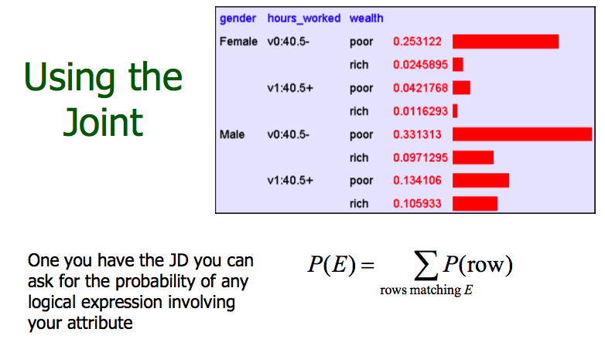
Note: these probabilities are from the UCI “Adult” Census, which you, too, can fool around with in your leisure ....

Slide 24
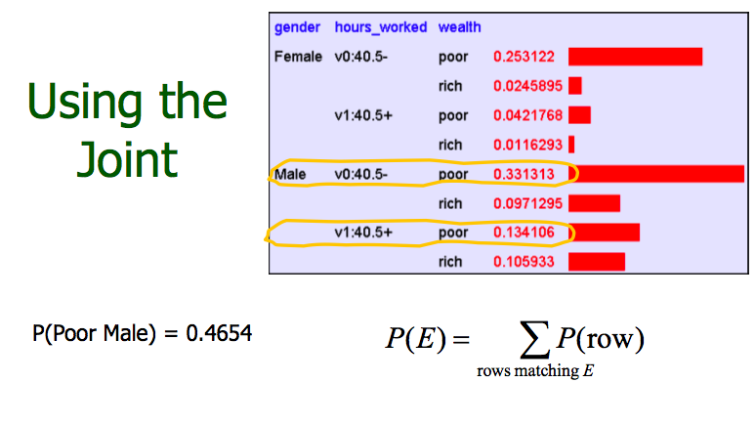

Slide 25
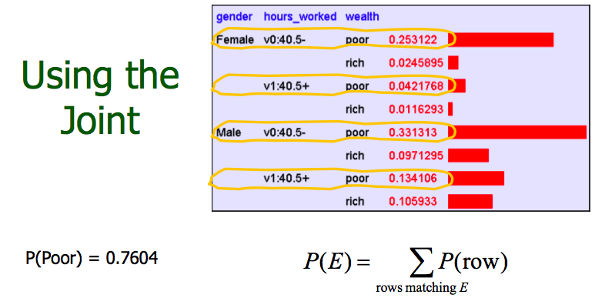

Slide 26
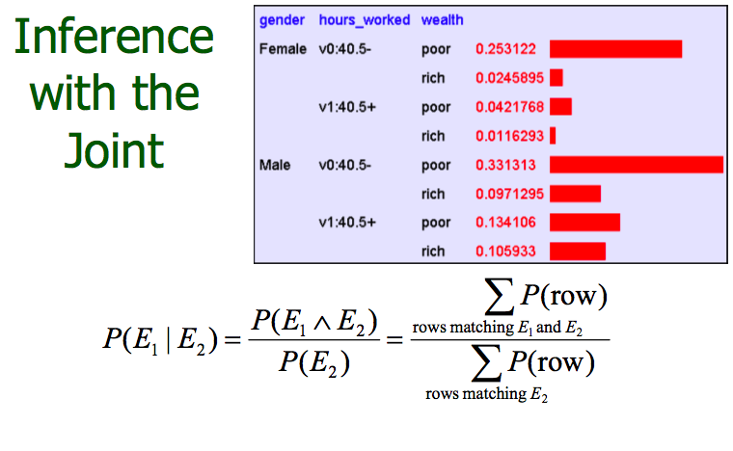

Slide 27
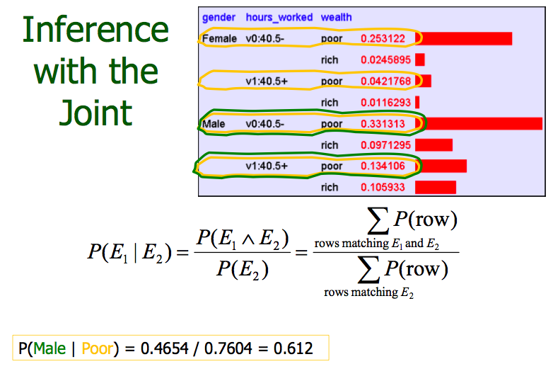

Slide 28
Where we are
We have been learning how to make inferences.
  I’ve got a sore neck: how likely am I to have the flu?
  The polls have a liberal president ahead by 5 points: how likely is he or she to win the election?
  This person is reading an email about guitars: how likely is he or she to want to buy guitar picks?
This is a big deal, as inference is at the core of a lot of industry. Predicting polls, the stock market, optimizing ad placements, etc., can potentially earn you money. Predicting a flu outbreak, moreover, can help the world (because, after all, money is not everything).

Slide 29
Independence
The census data is represented as vectors of variables, and the occurrence of values for each variable has a certain probability.
We will say that variables like {gender} and {hrs worked per week} are independent if and only if:
  P(hours worked | gender) = P(hours worked)
  P(gender | hours worked) = P(gender)

Slide 30
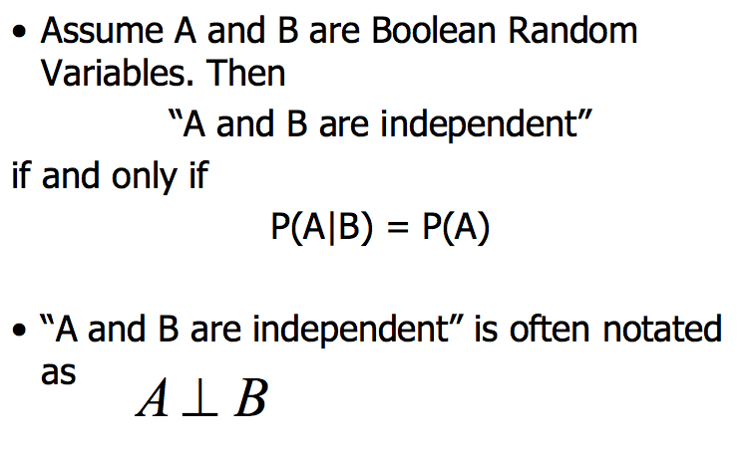
More generally

Slide 31
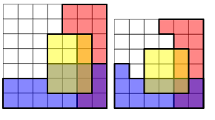
Conditional independence
These pictures represent the probabilities of events A, B and C by the areas shaded red, blue and yellow respectively with respect to the total area. In both examples A and B are conditionally independent given C because:
P(A^B| C) = P(A|C)P(B|C)
BUT A and B are NOT conditionally independent given ~C, as:
P(A^B|~ C) != P(A|~C)P(B|~C)

Slide 32
The Value of Independence
Complete independence reduces both representation of joint and inference from O(2^{n}) to O(n)!
Unfortunately, such complete mutual independence is very rare. Most realistic domains do not exhibit this property.
Fortunately, most domains do exhibit a fair amount of conditional independence. And we can exploit conditional independence for representation and inference as well.
Bayesian networks do just this.

Slide 33

Exploiting Conditional Independence
Let’s see what conditional independence buys us.
Consider a story:
  “If Craig woke up too early (E is true), Craig probably needs coffee (C); if Craig needs coffee, he's likely angry (A). If he is angry, he has an increased chance of bursting a brain vessel (B). If he bursts a brain vessel, Craig is quite likely to be hospitalized (H).”
E
C
A
B
H
E – Craig woke too early A – Craig is angry H – Craig hospitalized
C – Craig needs coffee B – Craig burst a blood vessel

Slide 34
Cond’l Independence in our Story
E
C
A
B
H
If you knew E, C, A, or B, your assessment of P(H) would change.
  E.g., if any of these are seen to be true, you would increase P(H) and decrease P(~H).
  This means H is not independent of E, or C, or A, or B.
If you knew B, you’d be in good shape to evaluate P(H). You would not need to know the values of E, C, or A. The influence these factors have on H is mediated by B.
  Craig doesn't get sent to the hospital because he's angry, he gets sent because he's had an aneurysm.
  So H is independent of E, and C, and A, given B

Slide 35
Cond’l Independence in our Story
E
C
A
B
H
Similarly:
      B is independent of E, and C, given A
      A is independent of E, given C
This means that:
      P(H | B, {A,C,E} ) = P(H|B)
        i.e., for any subset of {A,C,E}, this relation holds
      P(B | A, {C,E} ) = P(B | A)
      P(A | C, {E} ) = P(A | C)
      P(C | E) and P(E) don’t “simplify”

Slide 36
Cond’l Independence in our Story
E
C
A
B
H
By the chain rule (for any instantiation of H…E):
  P(H,B,A,C,E) =
  P(H|B,A,C,E) P(B|A,C,E) P(A|C,E) P(C|E) P(E)
By our independence assumptions:
  P(H,B,A,C,E) =
  P(H|B) P(B|A) P(A|C) P(C|E) P(E)
We can specify the full joint by specifying five local conditional distributions (joints): P(H|B); P(B|A); P(A|C); P(C|E); and P(E)

Slide 37
Example Quantification
P(C|E) = 0.8
P(~C|E) = 0.2
P(C|~E) = 0.5
P(~C|~E) = 0.5
P(B|A) = 0.2
P(~B|A) = 0.8
P(B|~A) = 0.1
P(~B|~A) = 0.9
E
C
A
B
H
P(E) = 0.7
P(~E) = 0.3
P(A|C) = 0.7
P(~A|C) = 0.3
P(A|~C) = 0.0
P(~A|~C) = 1.0
P(H|B) = 0.9
P(~H|B) = 0.1
P(H|~B) = 0.1
P(~H|~B) = 0.9
Specifying the joint requires only 9 parameters (if we note that half of these are “1 minus” the others), instead of 31 for explicit representation
  That means inference is linear in the number of variables instead of exponential!
  Moreover, inference is linear generally if dependence has a chain structure

Slide 38
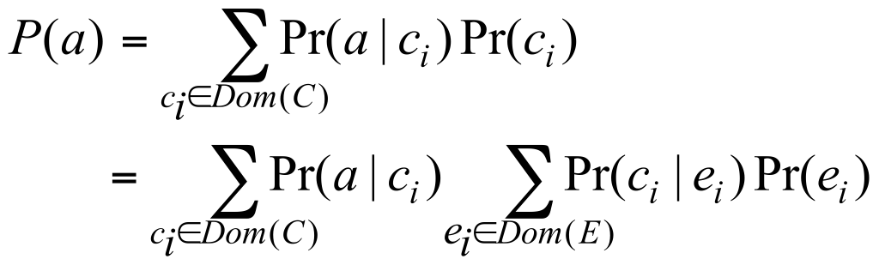
Inference
Want to know P(A)? Proceed as follows:
E
C
A
B
H
These are all terms specified in our local distributions!

Slide 39
Bayesian Networks
The structure we just described is a Bayesian network. A BN is a graphical representation of the direct dependencies over a set of variables, together with a set of conditional probability tables quantifying the strength of those influences.
Bayes nets generalize the above ideas in very interesting ways, leading to effective means of representation and inference under uncertainty.

Slide 40
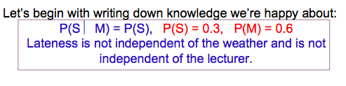

Let’s do another Bayes Net example with different instructors
M: Maryam leads tutorial
S: It is sunny out
L: The tutorial leader arrives late
Assume that all tutorial leaders may arrive late in bad weather. Some leaders may be more likely to be late than others.

Slide 41
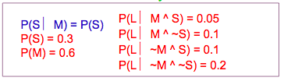
Bayes net example
M: Maryam leads tutorial
S: It is sunny out
L: The tutorial leader arrives late
Because of conditional independence, we only need 6 values in the joint instead of 7. Again, conditional independence leads to computational savings!

Slide 42
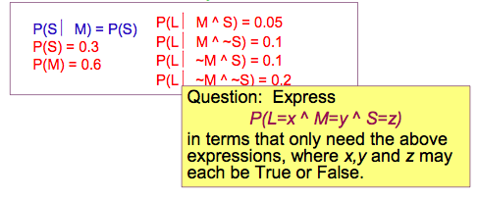
Bayes net example
M: Maryam leads tutorial
S: It is sunny out
L: The tutorial leader arrives late

Slide 43
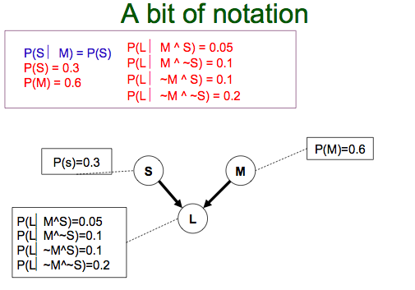
Read the absence of an arrow
between S and M to mean “It
would not help me predict M if I
knew the value of S”
Read the two arrows into L to
mean “If I want to know the
value of L it may help me to
know M and to know S.”

Slide 44
Adding to the graph
Now let’s suppose we have these three events:
M: Maryam leads tutorial
L: The tutorial leader arrives late
R : The tutorial concerns Reasoning with Bayes’ Nets
And we know:
  Abdel-rahman has a higher chance of being late than Maryam.
  Abdel-rahman has a higher chance of giving lectures about reasoning with BNs
What kind of independences exist in our graph?

Slide 45
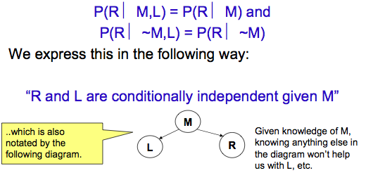
Conditional independence, again
Once you know who the lecturer is, then whether
they arrive late doesn’t affect whether the lecture
concerns Reasoning with Bayes’ Nets.

Slide 46
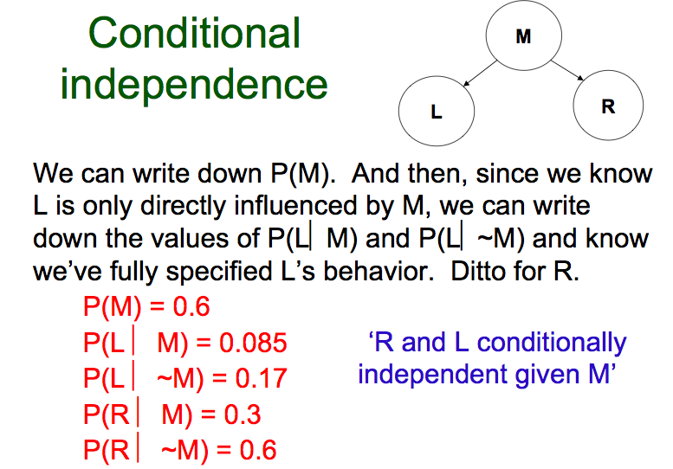

Slide 47
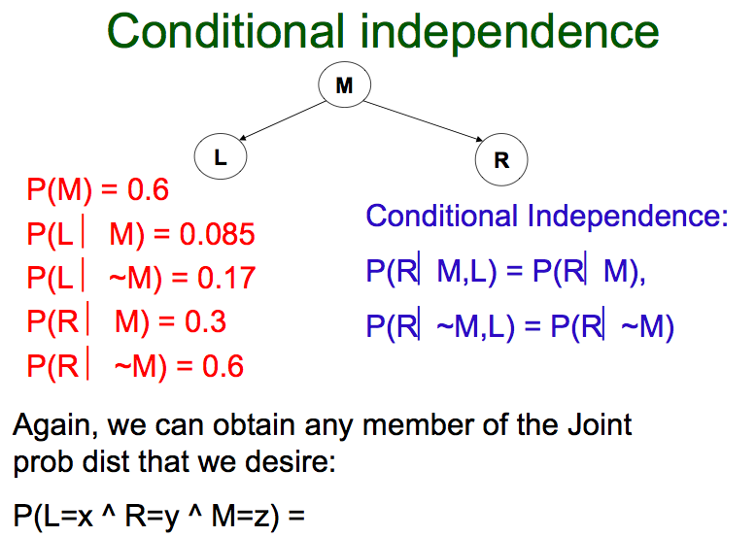

Slide 48
Let’s assume we have 5 variables
M: Maryam leads tutorial
L: The tutorial leader arrives late
R:The tutorial concerns Reasoning with BNs
S: It is sunny out
T: The tutorial starts by 10:15
We know:
T is only directly influenced by L (i.e. T is conditionally independent of R,M,S given L)
L is only directly influenced by M and S (i.e. L is conditionally independent of R given M & S)
R is only directly influenced by M (i.e. R is conditionally independent of L,S, given M)
M and S are independent

Slide 49
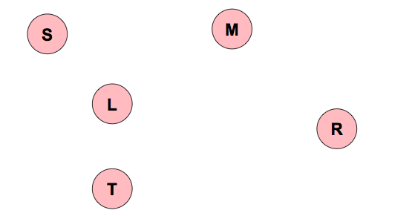
Let’s make a Bayes Net
M: Maryam leads tutorial
L: The tutorial leader arrives late
R : The tutorial concerns Reasoning in FOL
S: It is sunny out
T: The tutorial starts by 10:15
Step One: add variables.
• Just choose the variables you’d like to be included in the net.

Slide 50
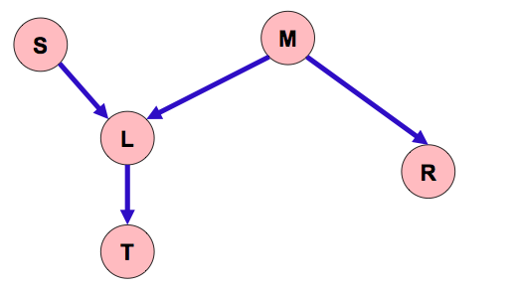
Making a Bayes Net
M: Maryam leads tutorial
L: The tutorial leader arrives late
R : The tutorial concerns Reasoning in FOL
S: It is sunny out
T: The tutorial starts by 10:15
Step Two: add links.
• The link structure must be acyclic.
• If node X is given parents Q1,Q2,..and Qn, you are promising
that any variable that’s a non-descendent of X is conditionally independent of X given {Q1,Q2,..and Qn}

Slide 51
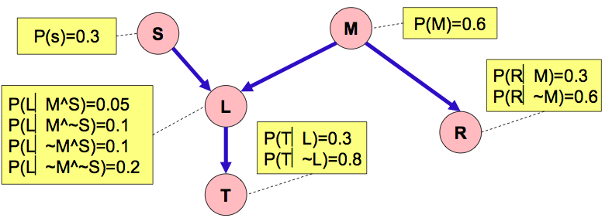
Making a Bayes Net
M: Maryam leads tutorial
L: The tutorial leader arrives late
R : The tutorial concerns Reasoning in FOL
S: It is sunny out
T: The tutorial starts by 10:15
Step Three: add a probability table for each node.
• The table for node X must list P(X|Parent Values) for each possible combination of parent values.

Slide 52
Making a Bayes Net
M: Maryam leads tutorial
L: The tutorial leader arrives late
R : The tutorial concerns Reasoning in FOL
S: It is sunny out
T: The tutorial starts by 10:15
• Two unconnected variables may still be correlated
• Each node is conditionally independent of all non-descendants in the tree, given its parents.
• You can deduce many other conditional independence relations from a Bayes net.

Slide 53
Bayesian Networks Formalized
A Bayes Net (BN, also called a belief network) is an augmented directed acyclic graph, represented by the pair V, E where: V is a set of vertices.
E is a set of directed edges joining vertices. No loops of any length are allowed.
Each vertex in V contains the following information: The name of a random variable
A probability distribution table (also called a Conditional Probability Table or CPT) indicating how the probability of this variable’s values depends on all possible combinations of parental values.
Key definitions (see text, all are intuitive): parents of a node (Parents(Xi)), children of node, descendants of a node, ancestors of a node, family of a node (i.e. the set of nodes consisting of Xi and its parents)
CPTs are defined over families in the BN

Slide 54
Building a Bayes Net
Choose a set of relevant variables. Choose an ordering for them.
Assume they’re called X1.. Xm (where X1 is the first in the ordering, X2 is the second, etc)
For i = 1 to m:
  Add the Xi node to the network.
  Set Parents(Xi) to be a minimal subset of {X1…Xi-1} such that we have conditional independence of Xi and all other members of {X1…Xi-1} given Parents(Xi).
  Define the probability table of P(Xi =k|Assignments of Parents(Xi)).

Slide 55
Building a Bayes Net
It is always possible to construct a Bayes net to represent any distribution over the variables X₁, X₂,…, X_{n}, using any ordering of the variables.
Take any ordering of the variables (say, the order given). From the chain rule we obtain.
P(X₁,…,X_{n}) = P(X_{n}|X₁,…,X_{n-1})P(X_{n-1}|X₁,…,X_{n-2})…P(X₁)
Now for each X_{i} go through its conditioning set X₁,…,X_{i-1}, and iteratively remove all variables X_{j} such that X_{i} is conditionally independent of X_{j} given the remaining variables. Do this until no more variables can be removed.
The final product will specify a Bayes net.
However, some orderings will yield BN’s with very large parent sets. This requires exponential space, and exponential time to perform inference.

Slide 56
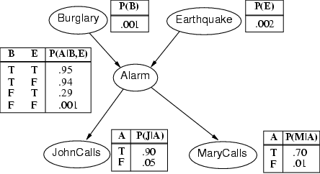
Burglary Example
A burglary can set the alarm off
An earthquake can set the alarm off
The alarm can cause Mary to call
The alarm can cause John to call
# of table entries:1 + 1 + 4 + 2 + 2 = 10 (vs. 2⁵-1 = 31)

Slide 57
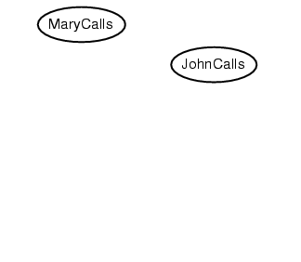
Burglary Example
Suppose we choose the ordering M, J, A, B, E
P(J | M) = P(J)?

Slide 58
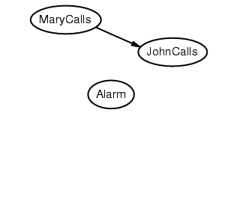
Burglary Example
Suppose we choose the ordering M, J, A, B, E
P(J | M) = P(J)?
No
P(A | J, M) = P(A | J)? P(A | J, M) = P(A)?

Slide 59
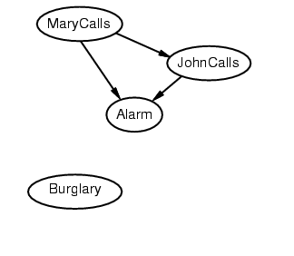
Burglary Example
Suppose we choose the ordering M, J, A, B, E
P(J | M) = P(J)?
No
P(A | J, M) = P(A | J)? P(A | J, M) = P(A)? No
P(B | A, J, M) = P(B | A)?
P(B | A, J, M) = P(B)?

Slide 60
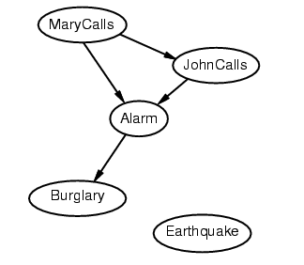
Burglary Example
Suppose we choose the ordering M, J, A, B, E
P(J | M) = P(J)?
No
P(A | J, M) = P(A | J)? P(A | J, M) = P(A)? No
P(B | A, J, M) = P(B | A)? Yes
P(B | A, J, M) = P(B)? No
P(E | B, A ,J, M) = P(E | A)?
P(E | B, A, J, M) = P(E | A, B)?

Slide 61
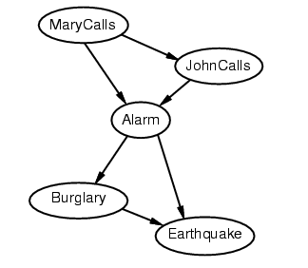
Burglary Example
Suppose we choose the ordering M, J, A, B, E
P(J | M) = P(J)?
No
P(A | J, M) = P(A | J)? P(A | J, M) = P(A)? No
P(B | A, J, M) = P(B | A)? Yes
P(B | A, J, M) = P(B)? No
P(E | B, A ,J, M) = P(E | A)? No
P(E | B, A, J, M) = P(E | A, B)? Yes

Slide 62
Burglary Example
Network is less compact: 1 + 2 + 4 + 2 + 4 = 13 numbers needed

Slide 63
O: Everyone is out of the house
L: The light is on
D: The dog is outside
B: The dog has bowel troubles
H: I can hear the dog barking
From this information, the following direct causal influences seem appropriate:
1. H is only directly influenced by D. Hence H is conditionally independent of L, O and B given D.
2. D is only directly influenced by O and B. Hence D is conditionally independent of L given O and B.
3. L is only directly influenced by O. Hence L is conditionally independent of D, H and B given O.
4. O and B are independent.

Slide 64
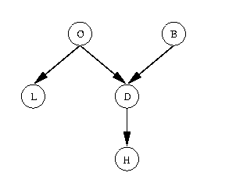
P(B,~O,D,~L,H) = P(H,~L,D,~O,B)
= P(H | ~L,D,~O,B) * P(~L,D,~O,B) -- by Product Rule
= P(H|D) * P(~L,D,~O,B) -- by Conditional Independence of H and L,O, and B given D
= P(H|D) P(~L | D,~O,B) P(D,~O,B) -- by Product Rule
= P(H|D) P(~L|~O) P(D,~O,B) -- by Conditional Independence of L and D, and L and B, given O
= P(H|D) P(~L|~O) P(D | ~O,B) P(~O,B) -- by Product Rule
= P(H|D) P(~L|~O) P(D|~O,B) P(~O | B) P(B) -- by Product Rule
= P(H|D) P(~L|~O) P(D|~O,B) P(~O) P(B) -- by Independence of O and B
= ?

Slide 65
More on independence in a BN
Is X independent of Z given Y?
Yes. All of X’s parents are given, and Z is not a descendent.
Y
X
Z

Slide 66
More on independence in a BN
Is X independent of Z, given U? No.
Is X independent of Z given U and V? Yes.
Is X independent of Z given S, if S cuts X from Z?
Z
U
V
X

Slide 67
The confusing independence relation
X has no parents; we know its parents values.
Z is not a descendent of X.
X is independent of Z, if we don’t know Y.
But what if we do know Y? Or the value of a descendant of Y?
X
Z
Y

Slide 68
OK. Let’s look at these issues in a Burglary network.
B
E
B = there is a burglar in your house
E = there is an earthquake
A = your alarm goes off
P = mary calls you to tell you your alarm is going off
A
P

Slide 69
Burglary Example, revisited
B = there is a burglar in your house
E = there is an earthquake
A = your alarm goes off
P = mary calls you to tell you your alarm is going off
B
E
Let’s say your alarm is twitchy and prone to go off.
Let’s also say your friend calls you to tell you he hears the alarm!
This will alter your feelings about the relative likelihood that the alarm was triggered by an earthquake, as opposed to a burglar.
The probability of B may be independent of E given no evidence.
But when you get a phone call (i.e. when you know P is true), B and E are no longer independent!!
A
P

Slide 70
d-separation
Conditionally independence between variables in a network is exists if they are d-separated.
X and Y are d-separated by a set of evidence variables E if and only if every undirected path from X to Z is “blocked”.

Slide 71
What does it mean to be blocked?
X
Y
There exists a variable V on the path such that
  it is in the evidence set E
  the arcs putting V in the path are “tail-to-tail”
Or, there exists a variable V on the path such that
  it is in the evidence set E
  the arcs putting V in the path are “tail-to-head”
V
X
Y
V

Slide 72
What does it mean to be blocked?
If the variable V is on the path such that the arcs putting V on the path are “head-to-head”, the variables are still blocked .... so long as:
  V is NOT in the evidence set E
  neither are any of its descendants
X
Y
V

Slide 73
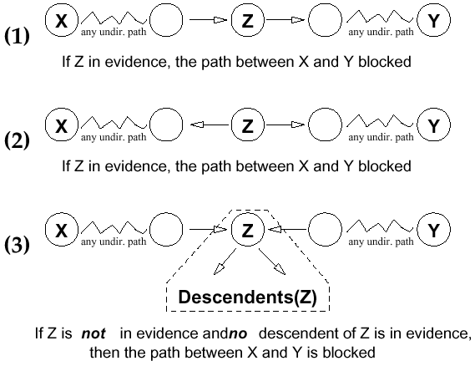
Blocking: Graphical View

Slide 74
d-separation implies conditional independence
Theorem [Verma & Pearl, 1998]: If a set of evidence variables E d-separates X and Z in a Bayesian network’s graph, then X is independent of Z given E.

Slide 75
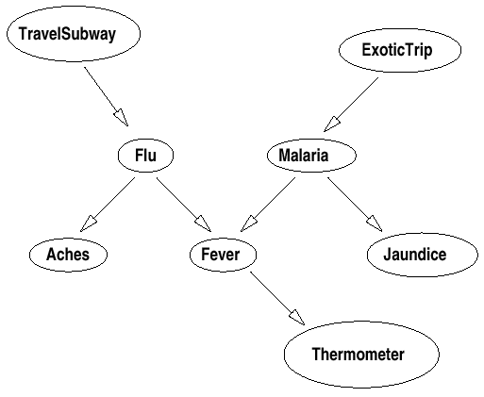
D-Separation: Intuitions
Subway and Therm are dependent; but are independent given Flu (since Flu blocks the only path)

Slide 76
D-Separation: Intuitions
Aches and Fever are dependent; but are independent given Flu (since Flu blocks the only path). Similarly for Aches and Therm (dependent, but indep. given Flu).

Slide 77
D-Separation: Intuitions
Flu and Mal are indep. (given no evidence): Fever blocks the path, since it is not in evidence, nor is its descendant Therm.
Flu and Mal are dependent given Fever (or given Therm): nothing blocks path now.

Slide 78
D-Separation: Intuitions
Subway, ExoticTrip are indep.;
they are dependent given Therm;
they are indep. given Therm and Malaria. This for exactly the same reasons for Flu/Mal above.

Slide 79
D-Separation Example
In the following network determine if A and E are independent given the evidence:
A
A and E given no evidence?
A and E given {C}?
A and E given {G,C}?
A and E given {G,C,H}?
A and E given {G,F}?
A and E given {F,D}?
A and E given {F,D,H}?
A and E given {B}?
A and E given {H,B}?
A and E given {G,C,D,H,D,F,B}?
G
C
H
D
F
B
E

Slide 80
D-Separation Example
In the following network determine if A and E are independent given the evidence:
A
A and E given no evidence? N
A and E given {C}? N
A and E given {G,C}? Y
A and E given {G,C,H}? Y
A and E given {G,F}? N
A and E given {F,D}? Y
A and E given {F,D,H}? N
A and E given {B}? Y
A and E given {H,B}? Y
A and E given {G,C,D,H,D,F,B}? Y
G
C
H
D
F
B
E

Slide 81
Summary
Now we have know what a BN looks like and we know how to determine which variables in it are conditionally independent.
We also have seen how one might use a BN to make inferences, i.e., to determine the probability of a break in, given that Mary called.
We have seen, however, that BNs may be more or less compact! These means inference can still be time and space consuming.

